Slide 1
Year 1 Phonics
Wednesday 8th March 2023

Slide 2
Year 1 Demo
globe

Slide 3
Year 1 Demo
teams

Slide 4
Year 1 Demo
bowl

Slide 5
Year 1 Demo
chase

Slide 6
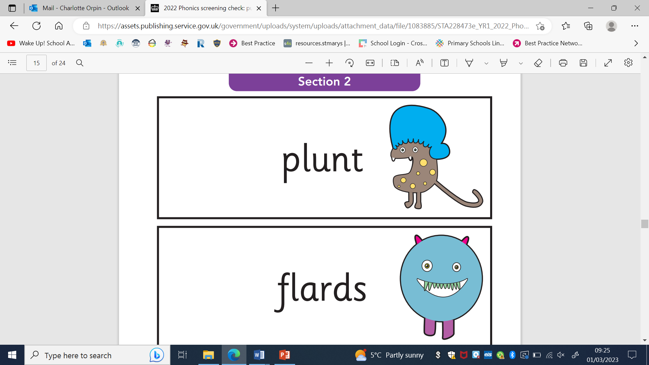
Year 1 Demo

Slide 7
Year 1 Demo

Slide 8
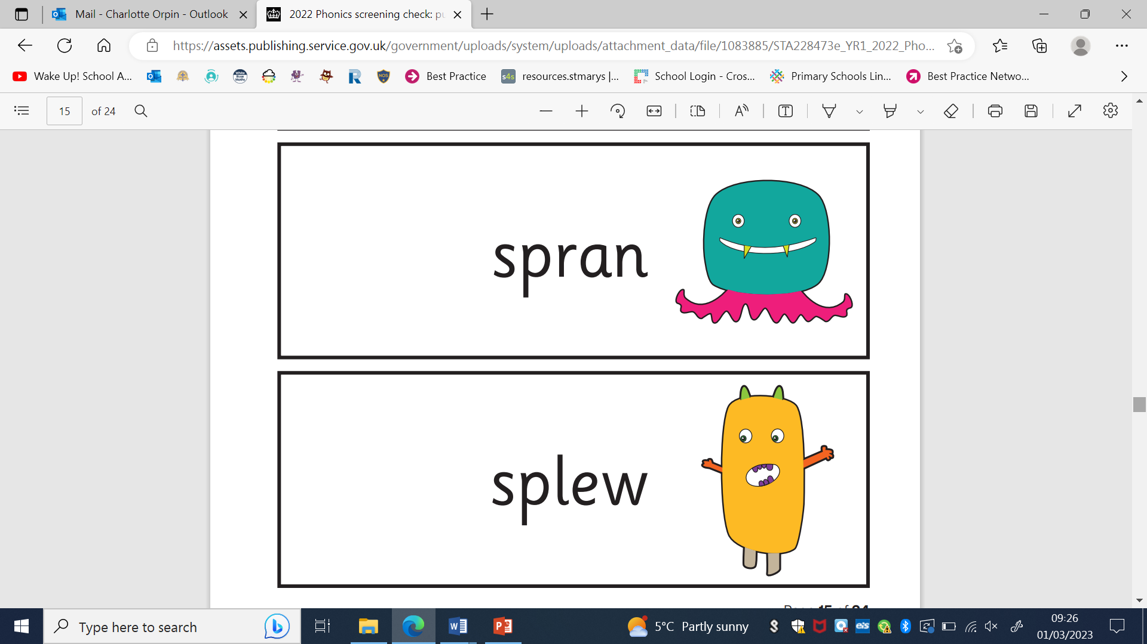
Year 1 Demo

Slide 9
Year 1 Demo

Slide 10
Phonics Screening Check
In June the Year 1 children have to take part in the Phonics Screening Check.
They have to read 20 real words and 20 alien words.
To pass they must read 32 out of the 40 words correctly.
It will look like the words the children have just read to us.
It is done 1:1 with Miss Newman in a very relaxed manner.

Slide 11
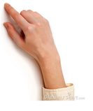
Decoding
stick
We learn to sound out words by blending; looking for letter groups.
/s/ /t/ /i/ /k/ “ stick ”
blend letter sounds to read
Notes:
Charlotte
Teach this routine well to the children. Point under, or tap under, each letter and letter group from left to right.
Run your finger under the whole word which allows a ‘moment’ to say the whole spoken word.
All the staff need to use the same phonics hand routines.

Slide 12

Spelling-with-editing routine
Face the same way as your child
Left hand, palm facing – make sure your child sees your hand ‘on the left’
Say the word to be spelt, very slowly – the individual sounds will ‘pop out’
Tally the sounds onto thumb and fingers
Repeat each sound separately and clearly
Then count how many sounds
segment sounds to spell
Notes:
Charlotte
All the staff can practise this routine and do it the same as one another. Remember not to face the children because the children need to see modelling in the same way as they do the tallying themselves.

Slide 13
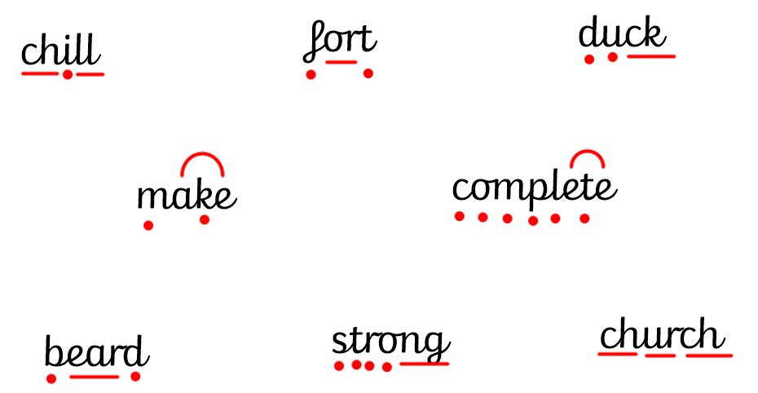
What are the children talking about when they say “dot, dash, dive”?
Notes:
Charlotte
In KS1 we use sound buttons and sound lines as a scaffold to support early segmenting and blending.

Slide 14
Why is Phonics important?
It helps us to read.
It helps us to write.
It helps in every subject.
It makes us more independent learners.

Slide 15
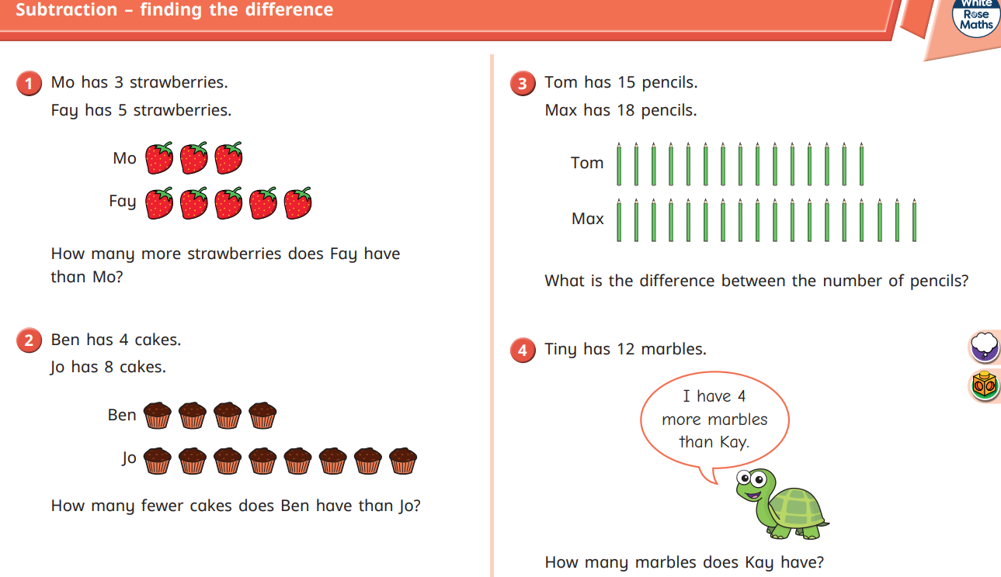
If we know Phonics we can read our maths sheets!

Slide 16
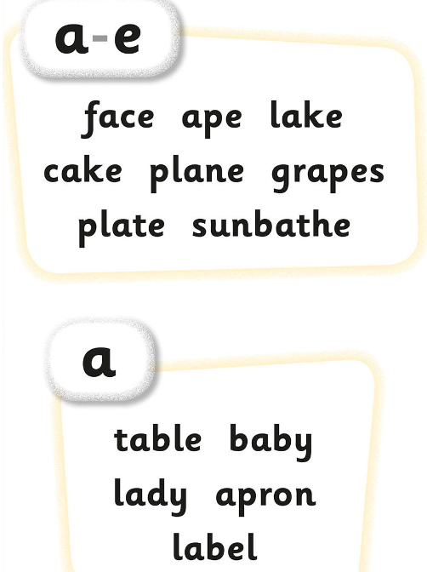
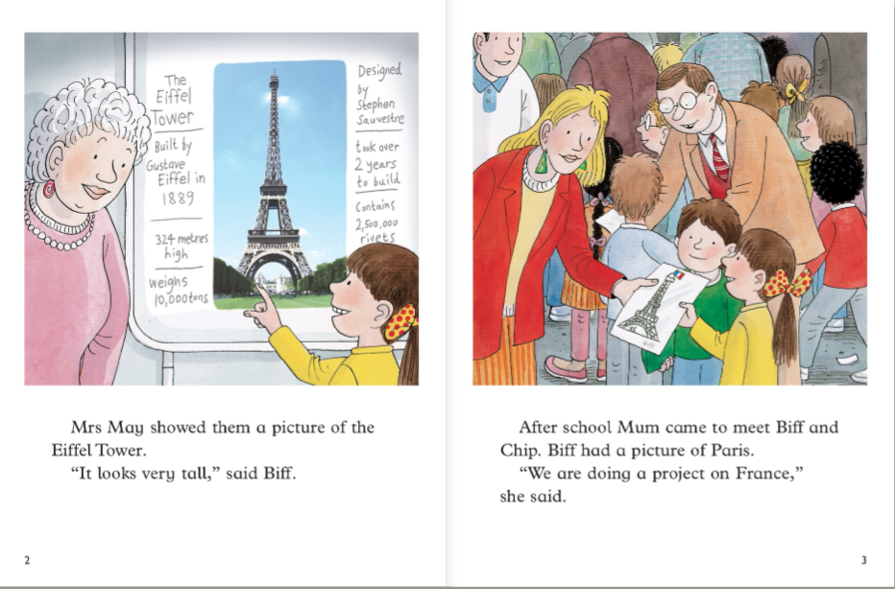
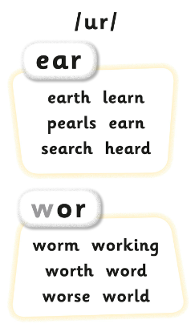
If we know Phonics we can read our Phonics books!

Slide 17
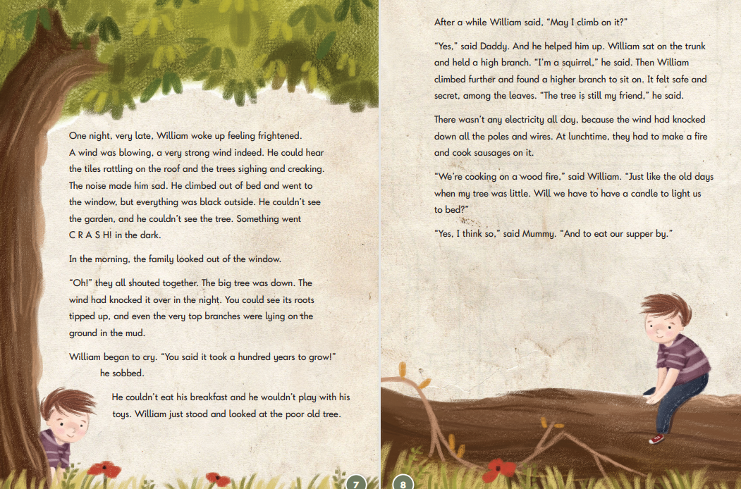
We are working towards the Year 2 SATS

Slide 18
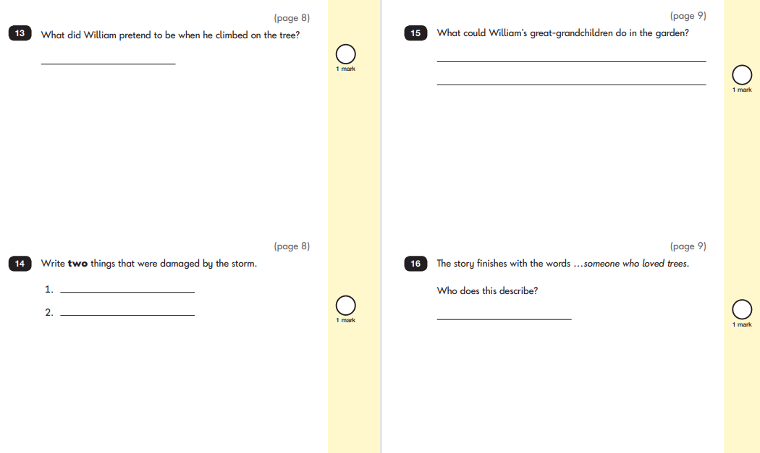
We are working towards the Year 2 SATS

Slide 19
New Homework
Each day you will get a new phonics word list.
The children have already read these words with us in school so it is just extra practice.
The children have to dot, dash, dive them to help with their Phonics Screening Test. Then you or your child can tick them if they have read them correctly.
Wednesday homework will be a Phonics Screening practise page.

Slide 20
Reading At Home
Please read with your child at home every day.
Just 5 minutes makes a massive difference to their reading.
Talk about the story with them to check they understand what they are reading.
Please bring their books into school everyday as we will read with them in school as well when we can.

Slide 21
Attendance
Please try to bring your child to school as much as possible.
If they are late in the morning they are missing out on their first Phonics lesson of the day which really affects their learning.
If they are late they also miss out on extra breakfast!

